Slide 1
Numerical Analysis & Computer Programming
Part 1: Basics of Programming
With Python
P. Arumugam (आरुमुगम)
Department of Physics
arumugam@ph.iitr.ac.in
Phone: 8979890366

Slide 2
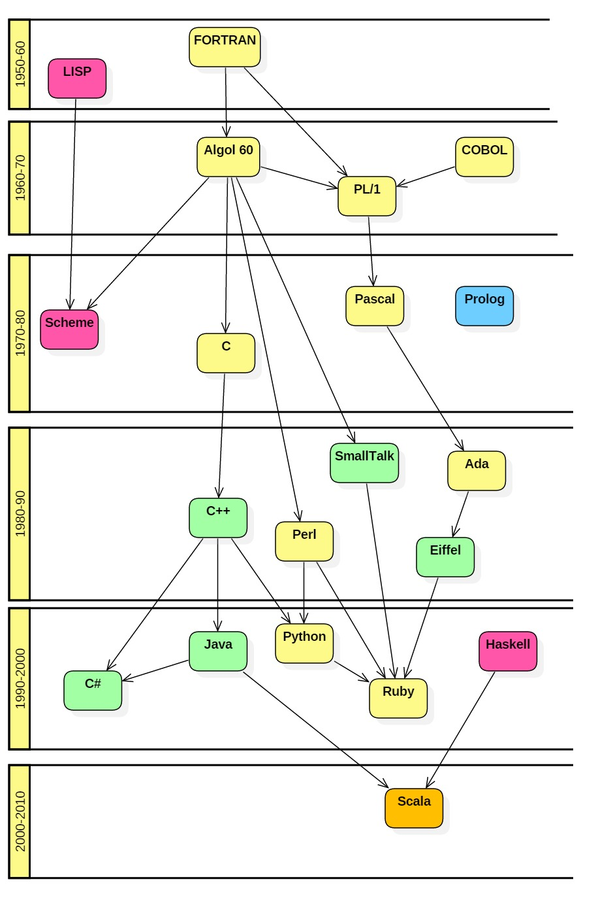
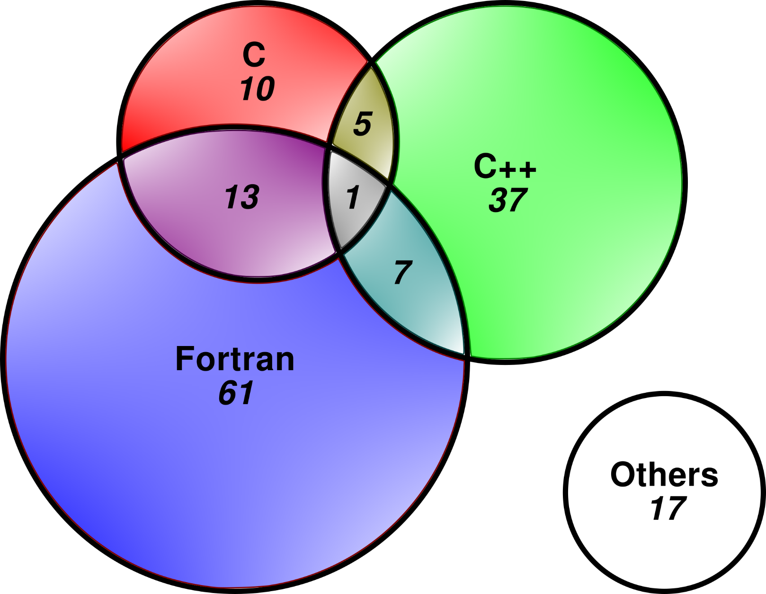
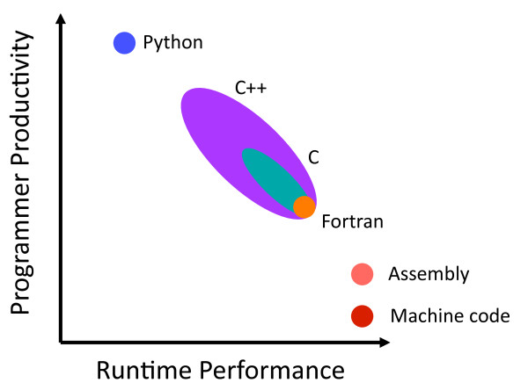
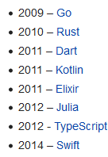
History of programming languages
High performance computation (HPC)

Slide 3
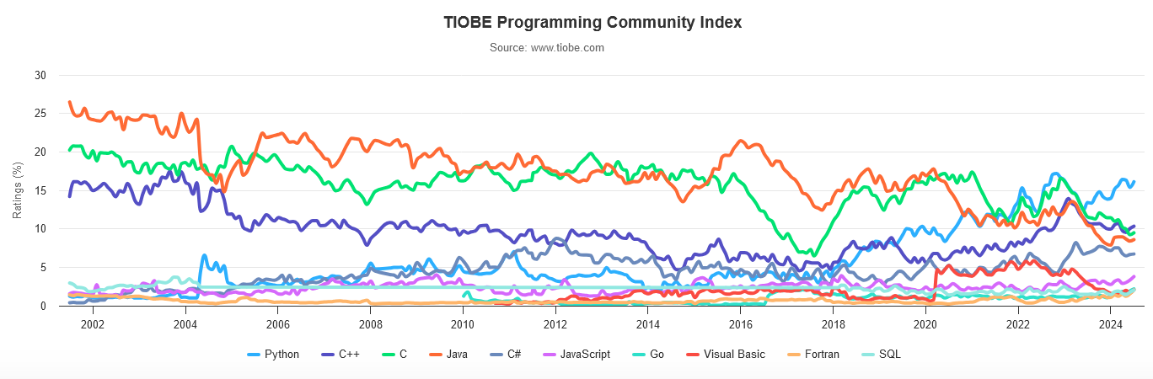
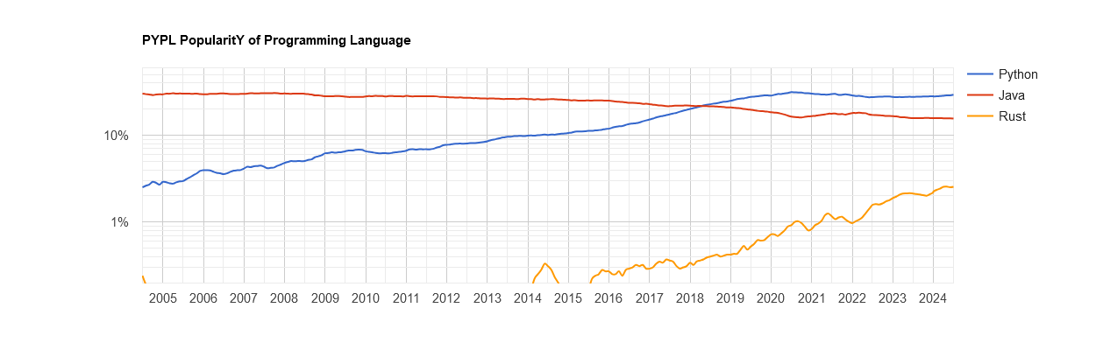
Recent trends

Slide 4
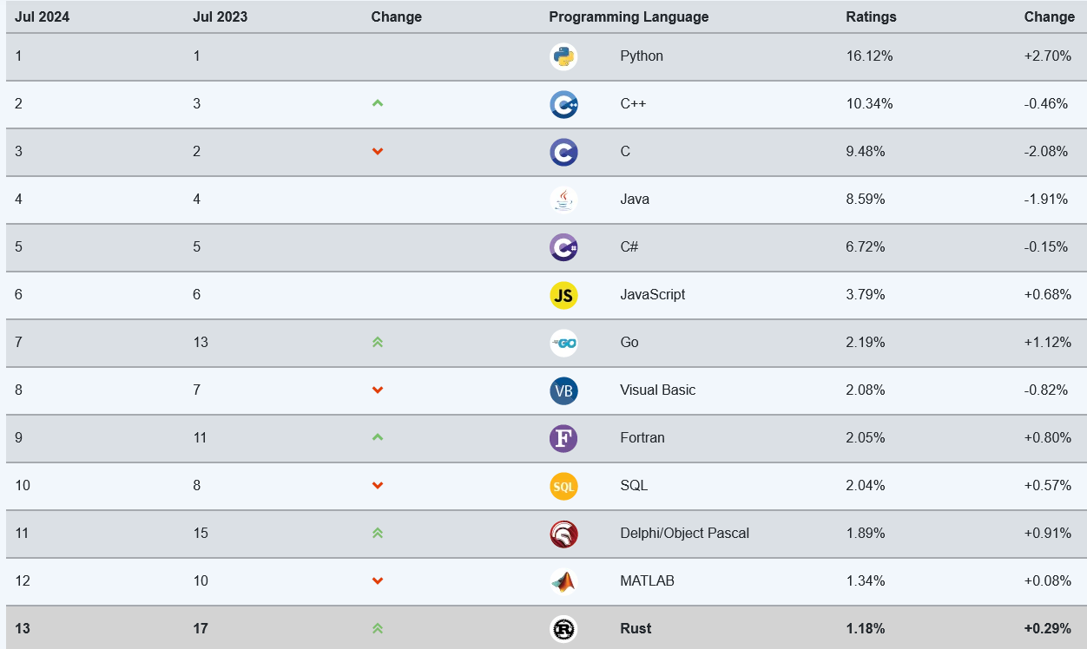
https://www.tiobe.com/tiobe-index/

Slide 5
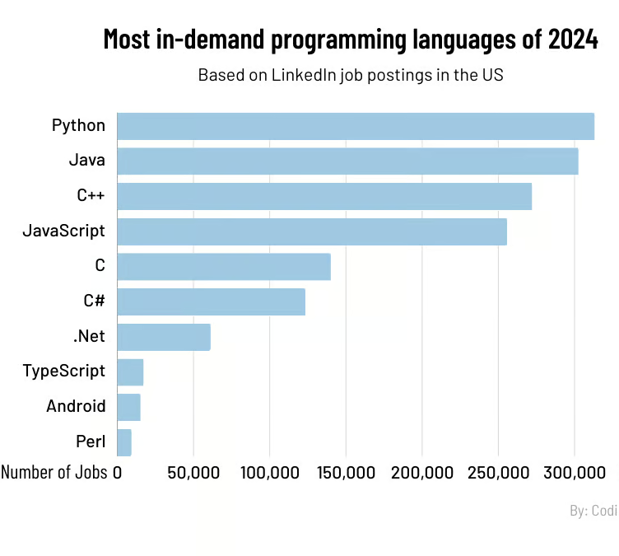
More Infographics
Most used programming languages among developers worldwide as of 2023
Note(s): Worldwide; May 8, 2023 to May 19, 2023; 87,585 respondents; Software developers
Source(s): Stack Overflow; ID 793628

Slide 6

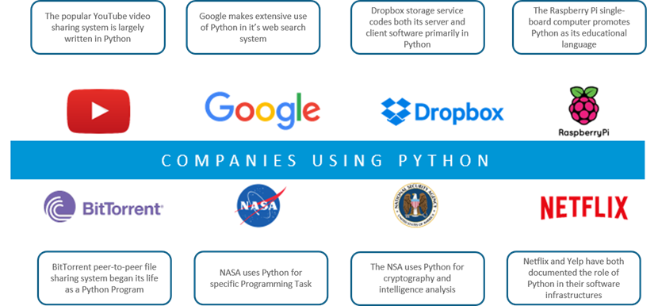
Famous companies that use python

Slide 7
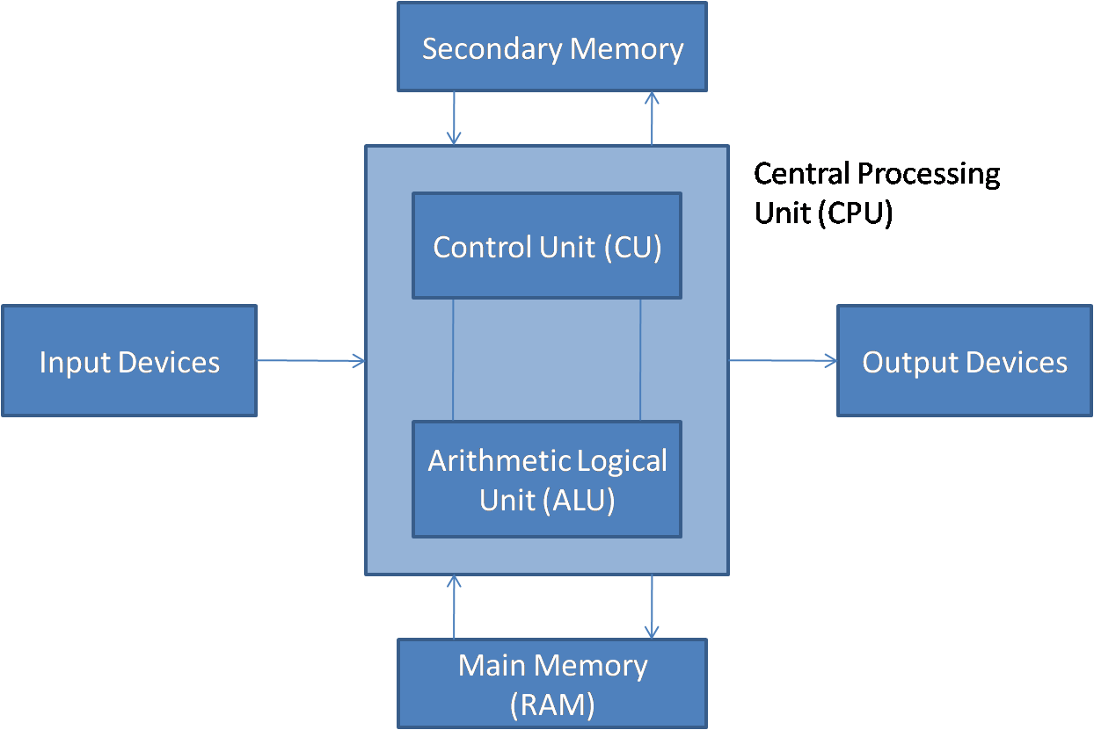
Basic architecture

Slide 8
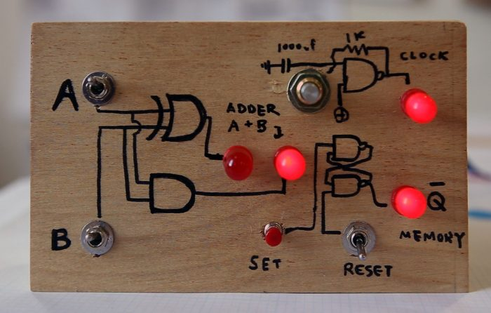
A 1-bit computer

Slide 9
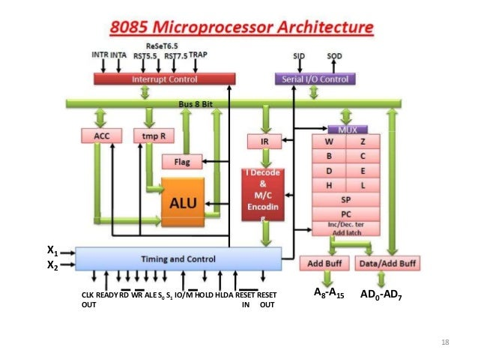

Slide 10
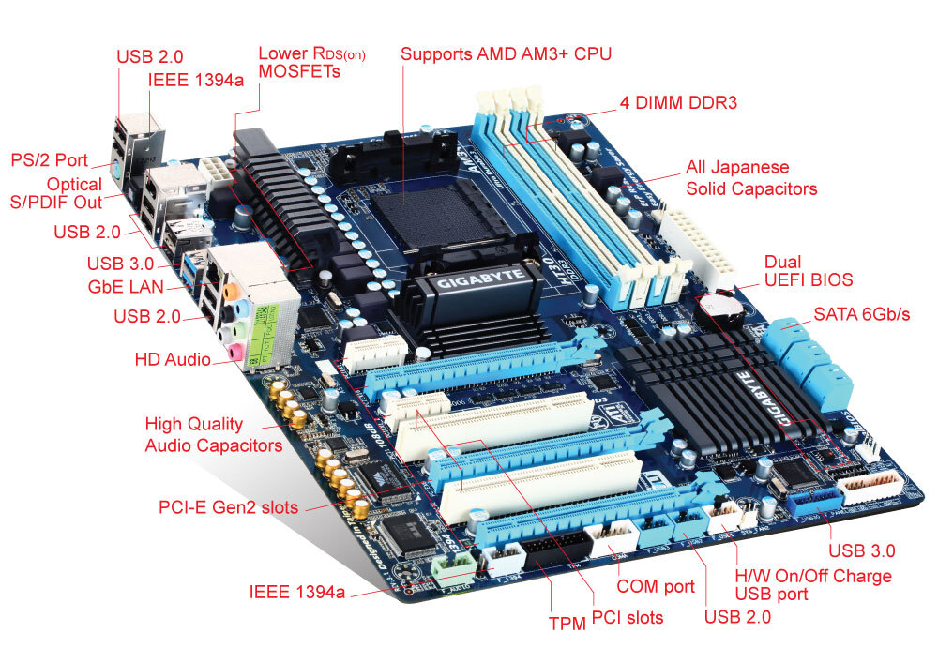
A motherboard

Slide 11
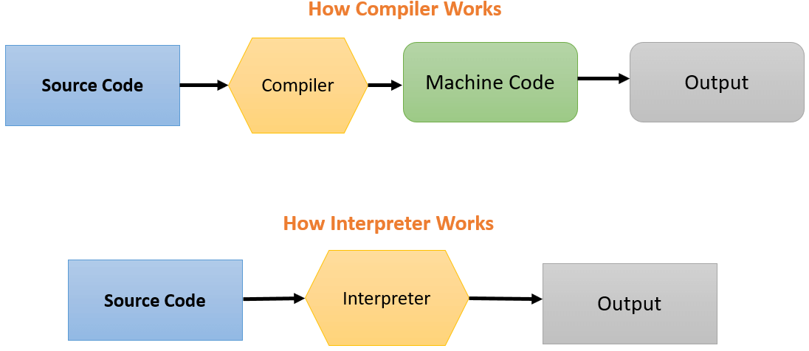
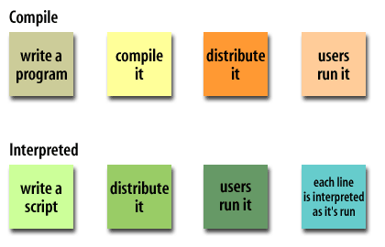
Compiler vs Interpreter

Slide 12
Data types
Integers: Integers are 32 bits long,–2³² to 2³² – 1.
Long Integers: unlimited precision, limited by the memory
Floating Point Numbers: Floating-point numbers are also known as double-precision numbers and use 64 bits.
Boolean: It can hold only one of two possible values: True or False.
Complex Number: has a real and an imaginary component, both represented by float types. 2+3j is a complex number.
Strings: Sequences of Unicode characters.
Lists: Ordered sequences of values.
Tuples: Ordered, immutable sequences of values.
Sets: Unordered collections of values.
Dictionaries: Unordered collections of key-value pairs.

Slide 13
Naming rules
You can use any names you want, as long as they follow these rules:
Names must start with either a letter or an underscore character ( _ ).
You can't use any of Python's reserved words or keywords.
These are words that have specific meanings to Python, such as if (which begins an if statement).
Names are case-sensitive. num is different from NUM and nUm.
By convention, most Python programmers use lowercase for names that stand for values. They use other rules for names that stand for functions and classes
It's a Good Idea to use meaningful names. If you name everything with a single-letter, for example, you may have trouble remembering what the name stands for later.

Slide 14
Continuation Lines
A physical line is a line that you see in a program.
A logical line is a single statement.
The end of a physical line marks the end of most statements (No ;).
When a statement is too long to fit on a single line, you can join two adjacent physical lines into a logical line by ensuring that the first physical line has no comment and ends with a backslash (\).
Python also joins adjacent lines into one logical line if an open parenthesis ( ( ), bracket ( [ ), or brace ( { ) is not closed.

Slide 15
Simple Text?
Unicode is a standard that uses 16-bit characters to represent characters on your computer. Unlike ASCII (American Standard Code for Information Interchange), which consists of 8 bits, Unicode uses 16 bits and represents characters by integer value denoted in base 16.
A number does not include any punctuation and cannot begin with a leading zero (0).
Leading zeros are used for base 2, base 8, and base 16 numbers.
For example, a number with a leading 0b or 0B is binary, base 2, and uses digits 0 and 1. Similarly, a number with a leading 0o is octal, base 8, and uses the digits 0 to 7, and a number with a leading 0x or 0X is hexadecimal, base 16, and uses the digits 0 through 9, plus a, A, b, B, c, C, d, D, e, E, f, and F.

Slide 16
Unary Operators

Slide 17
Arithmetic Operators

Slide 18
Relational Operators

Slide 19
Logical Operators

Slide 20
Bitwise Operators

Slide 21
Assignment Operators

Slide 22
Membership and Identity Operators

Slide 23
Operator precedence
16*2-2/4=?
PEMDAS
P – Parentheses.
E – Exponentiation.
M – Multiplication.
D – Division.
A – Addition.
S – Subtraction.
a="y"; b=0
a=="y" or a=="s" and b>=2
Ans: True

Slide 24
Associativity of Operators
Associativity is the order in which an expression is evaluated that has multiple operators of the same precedence. Almost all the operators have left-to-right associativity.
When two operators have the same precedence, associativity helps to determine the order of operations.
For example, multiplication and floor division have the same precedence. Hence, if both of them are present in an expression, the left one is evaluated first.
# Left-right associativity
# Output: 3
print(5 * 2 // 3)
# Output: 0
print(5 * (2 // 3))
# Right-left associativity of **
# Output: 512
print(2 ** 3 ** 2)
# Output: 64
print((2 ** 3) ** 2)

Slide 25
Non associative operators
Some operators like assignment operators and comparison operators do not have associativity in Python. There are separate rules for sequences of this kind of operator and cannot be expressed as associativity.
For example, x < y < z neither means (x < y) < z nor x < (y < z). x < y < z is equivalent to x < y and y < z, and is evaluated from left-to-right.
Furthermore, while chaining of assignments like x = y = z = 1 is perfectly valid, x = y = z+= 2 will result in error.
# Non associativity
# Output: True
print((1<4)<2)
# Output: False
print(1<4<2)
x = y = z = 1
# (Non-associative operators)
# SyntaxError: invalid syntax
x = y = z+= 2

Slide 26
Formatted print
>>> a=1+1/3.0
>>> print("%d" % a)
1
>>> print("%i" % a)
1
>>> print("%u" % a)
1
>>> print("%e" % a)
1.333333e+00
>>> print("%E" % a)
1.333333E+00
>>> print "%f" % a
1.333333
>>> print "%F" % a
1.333333
>>> print "%g" % a
1.33333
>>> print "%r" % a
1.3333333333333333
>>> print "%s" % a
1.33333333333

Slide 27
Version | Meaning
d | Signed integer decimal.
i | Signed integer decimal.
o | Unsigned octal.
u | Unsigned decimal.
x | Unsigned hexadecimal (lowercase).
X | Unsigned hexadecimal (uppercase).
e | Floating point exponential format (lowercase).
E | Floating point exponential format (uppercase).
f | Floating point decimal format.
F | Floating point decimal format.
g | Same as "e" if exponent is greater than -4 or less than precision, "f" otherwise.
G | Same as "E" if exponent is greater than -4 or less than precision, "F" otherwise.
c | Single character (accepts integer or single character string).
r | String (converts any python object using repr()).
s | String (converts any python object using str()).
% | No argument is converted, results in a "%" character in the result.

Slide 28
Formatted print
Flag | Meaning
# | The value conversion will use the ``alternate form'' (where defined above).
0 | The conversion will be zero padded for numeric values.
- | The converted value is left adjusted (overrides the "0" conversion if both are given).
+ | A sign character ("+" or "-") will precede the conversion (overrides a "space" flag).
>>> print("%9.2f" % a)
>>> print("%9.2e" % a)
>>> print("%+9.2f" % a)
>>> print("%-9.2f" % a)
>>> print("%09.2f" % a)
 |  |  |  |  | 1 | . | 3 | 3
 | 1 | . | 3 | 3 | e | + | 0 | 0
 |  |  |  | + | 1 | . | 3 | 3
1 | . | 3 | 3
0 | 1 | . | 3 | 3

Slide 29
Formatted print
>>> print("%9.2f" % a)
>>> print("%9.2e" % a)
>>> print("%+9.2f" % a)
>>> print("%-9.2f" % a)
>>> print("%09.2f" % a)
>>> print("%9.2g" % a)
1.3
>>> print("%9.2g" % 1e-5)
1e-05
>>> print("%9.2g" % 1e-4)
0.0001
 |  |  |  |  | 1 | . | 3 | 3
 | 1 | . | 3 | 3 | e | + | 0 | 0
 |  |  |  | + | 1 | . | 3 | 3
1 | . | 3 | 3
0 | 1 | . | 3 | 3

Slide 30
Formatted print
>>> print("%9.2g %f" % (1e-4, 2))
0.0001 2.000000
>>> print("%d, two, %s" % (1,3))
1, two, 3
Keywords
and assert break class continue def del elif else except exec finally for from global if import in is lambda not

Slide 31
Using Escape Sequences
print('Hello World\nIt\'s hot today')
print('Festival Discount\b\b\b\b\b\b\b\b\b Offer')
print("Isn't it?")
print('Isn\'t it?')
print("He said: \"I am going \"")
print('\\Text enclosed in back slashes\\')
print ('Bell sound \a')
print('Name\tEmail Address\tContact Number')
\a Bell (beep)
\b Backspace
\f Form feed
\n Newline
\r Carriage return
\t Tab
\v Vertical tab
\\ Literal backslash
\' Single quote
\" Double quote
Hello World
It's hot today
Festival Offerunt
Isn't it?
Isn't it?
He said: "I am going "
\Text enclosed in back slashes\
Bell sound
Name Email Address Contact Number

Slide 32
Miscellaneous features
Comments
# This program computes area of rectangle
a=2
b=3
a=b*c # values of b and c are multiplied
# and stored in a
Multiple Assignment Statements
a=b=c=1
p,q,r=10,20,30
sum, avg=p+q+r,(p+q+r)/3
del c
del a,b

Slide 33
Reading input from user
n = input('Enter a number: ')
print('You Entered:', n)
Enter a number: 10
You Entered: 10
print('Data type of n:', type(n))
Data type of num: <class 'str'>
print(n*2)
'1010'
n = int(input('Enter a number: '))
Enter a number: 10
print('Data type of n:', type(n))
Data type of num: <class 'int'>
print(n*2)
20
n = int(input('Enter a number: '))
Enter a number: 10.5
ValueError: invalid literal for int() with base 10: '10.5'
n = float(input('Enter a number: '))
Enter a number: 10.5
print('Data type of n:', type(n))
Data type of num: <class 'float'>

Slide 34
Lists & Tuples
b=[2,9,4] # List variable
c=('apple', 'mango', 'banana') # tuple variable
A tuple in python language refers to an ordered, immutable (non-changeable) set of values of any data type.
numbers = [3,4,1,9,6,2,8]
print(numbers)
numbers.insert(11,2)
print(numbers)
[3, 4, 1, 9, 6, 2, 8]
[3, 4, 11, 1, 9, 6, 2, 8]
numbers = [3,4,1,9,6,2,8]
print(numbers)
numbers.pop(4)
print(numbers)
[3, 4, 1, 9, 6, 2, 8]
[3, 4, 1, 9, 2, 8]

Slide 35
Functions
SYNTAX:
def function-name(Parameter list):
statements, i.e. the function body
Example:
def fahrenheit(T_in_celsius):
return (T_in_celsius*9/5) + 32
t=float(input(“Enter t: ”))
print(t, ": ", fahrenheit(t))
The output of this script looks like this:
22.6 : 72.68
25.8 : 78.44

Slide 36
Functions: Optional Parameters
Example:
def Hello(name="everybody"):
print("Hello " + name + "!")
>>> Hello("Peter")
>>> Hello()
The output of this script looks like this:
Hello Peter!
Hello everybody!

Slide 37
Functions: Keyword Parameters
def sumsub(a, b, c=0, d=0):
return a - b + c - d
>>> print(sumsub(12,4))
8
>>> print(sumsub(42,15,d=10))
17
>>> print(sumsub(42,15,0,10))
17
>>> print(sumsub())
Traceback (most recent call last):
File "<stdin>", line 1, in <module>
TypeError: sumsub() takes at least 2 arguments (0 given)

Slide 38
Functions: Return values
def no_return(x,y):
c = x + y
def empty_return(x,y):
c = x + y
return
def return_sum(x,y):
c = x + y
return c
def avg(*x):
return sum(x)/len(x)
>>> res = no_return(4,5)
>>> print(res)
None
>>> res = empty_return(4,5)
>>> print(res)
None
>>> res = return_sum(4,5)
>>> print(res)
9
>>> a=[1, 2, 3]
>>> avg(*a)
2

Slide 39
Functions: scope of variables
def fun1():
x=4
def fun2():
print x # from fun1's scope
fun2() # Prints 4
x=5
fun2() # Prints 5
print x # Prints 5
x = 5
def fun():
print(x)
fun() # Prints 5
x = 5
def fun():
print(x)
x += 1 # makes x a local variable!
fun() # UnboundLocalError!
def fun1():
x=4
def fun2():
x=6
print x # from fun2's scope
fun2() # Prints 6
x=5
fun2() # Prints 6
print x # Prints 5

Slide 40
Functions: global
>>> myGlobal = 5
def func1():
myGlobal = 42
def func2():
print myGlobal
>>> func1()
>>> func2()
5
>>> myGlobal = 5
def func1():
global myGlobal
myGlobal = 42
def func2():
print myGlobal
>>> func1()
>>> func2()
42

Slide 41
Python Scope resolution: LEGB Rule
These rules specific to variable names
L, Local — Names assigned in any way within a function (def), and not declared global in that function.
E, Enclosing function locals — Name in the local scope of any and all enclosing functions (def), from inner to outer.
G, Global (module) — Names assigned at the top-level of a module file, or declared global in a def within the file.
B, Built-in (Python) — Names preassigned in the built-in names module: open, range,...
def fun1():
x=4
def fun2():
print x
bar() # Prints 4
x=5
fun2() # Prints 5
print x # Prints 5
Built-in
Global
Enclosing
Local

Slide 42
Lists are mutable → editable in sub blocks
def f(t):
print(a,b)
a[1]=5
# b=b+8
c=[1,2,3]
return t**2
a=[1,2,3]
d=a
b=2
t=f(5)
#c[1]=9
#print(t,a,b,c)
print(t,a,b,d)
Changing an element in a mutable list defined in enclosing function
UnboundLocalError: local variable 'b' referenced before assignment
NameError: name 'c' is not defined
Referencing the same list !
NOT creating a new list !!
Use d=a.copy() for creating
[1, 2, 3] 2
25 [1, 5, 3] 2 [1, 5, 3]
Changing “a” changes “d”

Slide 43
Flow control in functions
Sequential
Function
Nested Function
def fun(x):
def fun1(x1):
Start
def fun2(x2):
Start
y2=fun2(x2)
y=fun(x)
Line1
Line2
Line3
Line4
Line5
Start
def fun(x):
return x**2
x=int(input("x"))
y=fun(x)
print(y)
y1=fun1(x1)

Slide 44
Flow control
Sequential
Conditional
Looping
Yes
?
No
?
Yes
No
x=int(input("x"))
print(x)
if x > 5:
print("x > 5")
print("end")
x=int(input("x"))
n = 1
while n < x:
print(n)
n += 1
print("end")
Line1
Line2
Line3
Line4
Line5
Yes
No
Yes
No

Slide 45
if – else statements
Yes
?
No
Yes
?
No
x = int(input("x"))
print(x)
if x > 5:
print("x > 5")
else:
print("x <= 5")
print("end")
x=int(input("x"))
print(x)
if x > 5:
print("x > 5")
print("end")
Yes
No
Yes
No

Slide 46
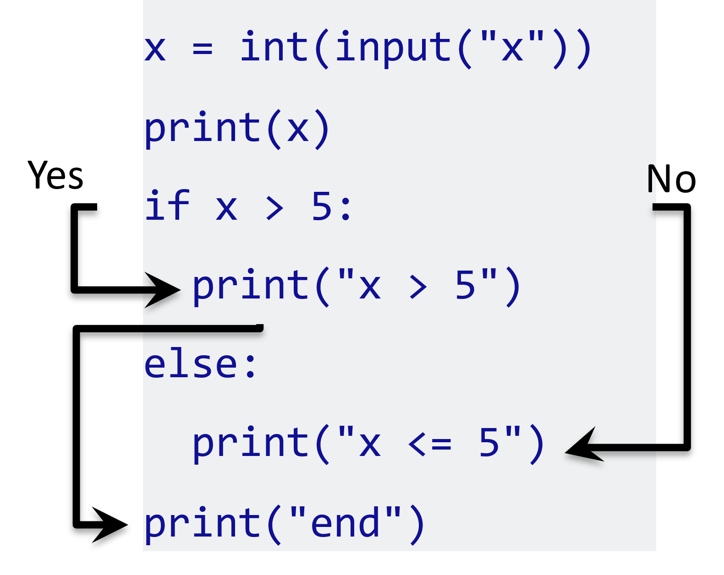
if – elif – else: Nesting
Yes
?
No
← A simple If-else construct
x = int(input("x"))
print(x)
if x > 5:
print("x > 5")
elif x < 5:
print("x < 5")
Else:
print("x = 5")
print("end")
Yes
?
No
Yes
No
Yes
?
No
Yes
No

Slide 47
Examples
x = int(input("x"))
if x < 0:
x = 0
print('Changed to zero')
elif x == 0:
print('Zero')
elif x == 1:
print('Single')
else:
print('More')
number = int(input("Number"))
# outer if statement
if (number >= 0):
# inner if statement
if number == 0:
print('Number is 0')
# inner else statement
else:
print('Number is positive')
# outer else statement
else:
print('Number is negative')
# Output: Number is positive
Exercises
Quadratic Equation
Odd or even
Grades for marks
Tut1

Slide 48
while loop
# program to calculate the sum of numbers
# until the user enters zero
total = 0
number = int(input('Enter N: '))
while number != 0:
total += number
number = int(input('Enter next N: '))
print('total =', total)
?
Yes
No
x = input("x")
n = 1
while n < x:
print(n)
n += 1
print("end")
If the condition of a loop is always True, the loop runs for infinite times (until the memory is full).
Yes
No
age = 32
# the test condition is always True
while age > 18:
print('You can vote')

Slide 49
while loop with else, break
Yes
counter = 0
while counter < 3:
print('Inside loop')
counter = counter + 1
else:
print('Inside else')
print('End')
No
Inside loop
Inside loop
Inside loop
Inside else
End
?
Yes
No
The else block will not execute if the while loop is terminated by a break statement.
counter = 0
while counter < 3:
if counter == 1:
break
print('Inside loop')
counter = counter + 1
else:
print('Inside else')
print('End')
Yes
No
Inside loop
End
No
?
?
Yes
No
Yes

Slide 50
while loop with continue
?
No
Yes
No
?
?
No
?
Yes
No
Yes
Yes
break
continue
Continue: skips the current iteration and the control flow goes to the next iteration
num = 0
while num < 10:
num += 1
if (num % 2) == 0:
continue
print(num)
print('End')
Yes
No
1
3
5
7
9

Slide 51
for loop
A for loop is used to iterate over sequences such as lists, tuples, string, etc.
while: Boolean expression
for: part of sequence?
n=[1,2,3]
for i in n:
print(i)
1
2
3
?
Yes
n=(1,2,3)
for i in n:
print(i)
1
2
3
No
n=[1,2,3]
for i in n:
print(i)
n[1]=4
print(n)
1
4
3
[1, 4, 3]
Yes
for i in [1,2,3]:
print(i)
print("end")
No
1
2
3
end
n=(1,2,3)
for i in n:
print(i)
n[1]=4
print(n)
1
2
3
for x in 'PHY':
print(x)
P
H
Y
TypeError: 'tuple' object does not support item assignment

Slide 52
for loop with break, continue, else
for i in [1,2,3,4]:
if i==3:
break
print(i)
print('End')
for i in [1,2,3,4]:
if i==3:
continue
print(i)
print('End')
1
2
4
End
1
2
End
No
for i in [1,2,3,4]:
if i==3:
break
print(i)
else:
print('else')
print('End')
for i in [1,2,3,4]:
if i==3:
continue
print(i)
else:
print('else')
print('End')
1
2
End
1
2
4
else
End
for i in range(2):
print(i)
print('End')
0
1
End
Notes:
Python break and continue (With Examples) (programiz.com)

Slide 53
Nested for loops
✓
✗
✗
for i in [1,2,3,4]:
if i==3:
break
for j in [1,2,3,4]:
if j==i:
break
print('j= ',j)
print('i= ',i)
print('End')
i= 1
j= 1
i= 2
End
Loops don’t cross and Break exits the inner loop
def fun(n):
for i in range(n):
for j in [1,2]:
if i==3:
return 3
print(i,j)
a=fun(5)
print('End')
0 1
0 2
1 1
1 2
2 1
2 2
End
for i in [1,2]:
j=i
for i in [1,2]:
k=i
print('in:',i,j,k)
print('out:',i,j,k)
print('End')
in: 1 1 1
in: 2 1 2
out: 2 1 2
in: 1 2 1
in: 2 2 2
out: 2 2 2
End
Notes:
Python break and continue (With Examples) (programiz.com)

Slide 54
range command
range(stop)
range(start, stop[, step])
The arguments to the range constructor must be integers
Contents of a range r are determined by r[i]=start+step*i where i>=0
For a positive step r[i]<stop and for a negative step r[i]>stop .
A range object will be empty if r[0] does not meet the value constraint.
Ranges do support negative indices, but these are interpreted as indexing from the end of the sequence determined by the positive indices.
>>> list(range(5, 10))
[5, 6, 7, 8, 9]
>>> list(range(0, 10, 3))
[0, 3, 6, 9]
>>> list(range(-1, -10, -3))
[-1, -4, -7]
>>> r = range(0, 20, 2)
>>> 11 in r
False
>>> 10 in r
True
>>> r.index(10)
5
>>> r[5]
10
>>> r[-1]
18

Slide 55
More on lists
a = [1,2,3]
print(len(a))
3
a=[1, "banana", True]
print(type(a))
for i in a:
print(type(i))
<class 'list'>
<class 'int'>
<class 'str'>
<class 'bool'>
print(a[1])
print(a[-1])
print(a[:])
print(a[0:1])
print(a[:1])
print(a[1:])
print(a[-3:-1])
if "banana" in a:
print("success")
banana
True
[1, 'banana', True]
[1]
[1]
['banana', True]
[1, 'banana']
success

Slide 56
More on lists (contd.)
a[1]=5; print(a)
a[0:2]=[3,4]; print(a)
a[0:1]=[7,8]; print(a)
[1, 5, True]
[3, 4, True]
[7, 8, 4, True]
a.insert(1,9); print(a)
a.pop(1); print(a)
a.append('PY’); print(a)
[7, 9, 8, 4, True]
[7, 8, 4, True]
[7, 8, 4, True, 'PY']
a.append([1,2]); print(a)
a.extend(a); print(a)
a.remove(7); print(a)
[7, 8, 4, True, 'PY', [1, 2]]
[7, 8, 4, True, 'PY', [1, 2], 7, 8, 4, True, 'PY', [1, 2]]
[8, 4, True, 'PY', [1, 2], 7, 8, 4, True, 'PY', [1, 2]]
a.sort()
a.sort(reverse=True)
a.reverse()
a[::-1]
a.count()
a.index()
i= [n**2 for n in range(1, 6)]
Output: [1, 4, 9, 16, 25]
fruits = ["apple", "banana", "cherry", "kiwi", "mango"]
newlist = [x for x in fruits if "a" in x]; print(newlist)
['apple', 'banana', 'mango']

Slide 57
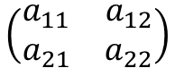
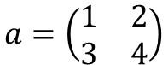
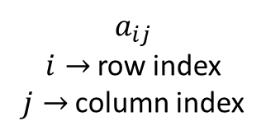
More on lists (contd.)
fruits = ["apple", "banana", "cherry"]
[green, yellow, red] = fruits
print(green,yellow,red)
apple banana cherry
fruits = ["apple", "banana", "cherry", "strawberry"]
[green, yellow, *red] = fruits
apple banana ['cherry', 'strawberry']
Most of these operations (except those which change the values) are applicable for tuples also. E.g. sort, append, etc., wont work with tuples
Multi-dimensional arrays are possible with lists/tuples. We will use numpy arrays (to be defined later) for this purpose
thistuple = ("apple", "banana", "cherry")
y = list(thistuple); y.append("orange")
thistuple = tuple(y)
>>> a=[[1,2],[3,4]]
>>> a[0]
[1, 2]
>>> a[0][0]
1
>>> a[1][0]
3
>>> a[0][1]
2
$$a=\left(\begin{matrix}1 & 2 \\ 3 & 4\end{matrix}\right)$$
$$a_{ij}$$
$i→$row index
$j→$column index
$$\left(\begin{matrix}a_{11} & a_{12} \\ a_{21} & a_{22}\end{matrix}\right)$$

Slide 58
Lists vs Tuples
# | LIST | TUPLE
1 | Lists are mutable | Tuples are immutable
2 | The implication of iterations is Time-consuming | The implication of iterations is comparatively Faster
3 | The list is better for performing operations, such as insertion and deletion. | A Tuple data type is appropriate for accessing the elements
4 | Lists consume more memory | Tuple consumes less memory as compared to the list
5 | Lists have several built-in methods | Tuple does not have many built-in methods.
6 | Unexpected changes and errors are more likely to occur | In a tuple, it is hard to take place.

Slide 59
Sets & Dictionaries
There are four ways to handle arrays
List [] is a collection which is ordered and changeable. Allows duplicate members.
Tuple () is a collection which is ordered and unchangeable. Allows duplicate members.
Set {} is a collection which is unordered, and unindexed.
Unchangeable, but you can remove items and add new items.
No duplicate members.
.difference, .intersection, .union, etc.,.
Dictionary is a collection which is ordered and changeable.
{key1:value1, key2:value2, …}
No duplicate members.
Only since v 3.7, dictionaries are ordered
.get, .items, .keys, .values, etc.

Slide 60
match-case
def fundamental_interaction(interaction):
match interaction:
case "Gravitational":
return "Described by Newton's Law of Universal Gravitation.“
case "Electromagnetic":
return "Described by Maxwell's equations.“
case "Weak Nuclear":
return "Involved in processes like beta decay."
case "Strong Nuclear":
return "Described by Quantum Chromodynamics (QCD)."
case _:
return "Unknown or not a fundamental interaction."
interaction = "Gravitational"
result = fundamental_interaction(interaction)
print(interaction, "Interaction: ", result)
The special pattern _ (and called wildcard) always matches but it doesn’t bind any variables.

Slide 61
match-case: def with additional inputs
def calculate_force(interaction_type, quantity1, quantity2, distance):
G = 6.67430e-11 # Gravitational constant in m^3/kg/s^2
k = 8.9875e9 # Coulomb's constant in Nm^2/C^2
match interaction_type:
case "Gravitational":
return (G * quantity1 * quantity2) / (distance ** 2)
case "Electromagnetic":
return (k * abs(quantity1 * quantity2)) / (distance ** 2)
case "Weak Nuclear":
# Custom calculation for weak nuclear force (illustrative)
return quantity1 * quantity2 / distance
case "Strong Nuclear":
# Custom calculation for strong nuclear force (illustrative)
return quantity1 * quantity2 / (distance ** 2)
case _:
return "Unknown interaction type"
interaction = "Gravitational"
quantity1 = 5.972e24
quantity2 = 7.347e22
distance = 384400e3
force = calculate_force(interaction, quantity1, quantity2, distance)
print(interaction, "Interaction Force: ", force, " N")

Slide 62
match-case: multiple variables
# point is an (x, y) tuple
match point:
case (0, 0):
print("Origin")
case (0, y):
print(f"Y={y}")
case (x, 0):
print(f"X={x}")
case (x, y):
print(f"X={x}, Y={y}")
case _:
raise ValueError("Not a point")
if x < 0: raise Exception("only +ve ")
if not type(x) is int: raise TypeError("Only integers")
---------------------------------------------------
ValueError Traceback (most recent call last)
<ipython-input-4-0e299d68a836> in <module>
5 case _:
----> 6 raise ValueError("Not a point")
7
ValueError: Not a point

Slide 63
Lambda (inline function)
Python supports the creation of anonymous functions (i.e. functions that are not bound to a name) at runtime, using a construct called "lambda".
>>> def f (x): return x**2
...
>>> print f(8)
64
>>>
>>> g = lambda x: x**2
>>>
>>> print g(8)
64
>>> g=lambda x,y: x+y
>>> g(2,3)
5
ke= lambda m,v: 0.5*m*v**2
m = 5.0 # Mass of the object in kg
v = 10.0 # Velocity of the object in m/s
print(f"KE = {ke(m,v):.2f} joules.")

Slide 64
Reading Files
file1
open(filename, mode)
>>> f = open('file1', ‘r')
>>> f=open('file1')
>>> f.read()
'this is line 1\nthis is line 2\nthis is line 3\n'
>>> f.read()
''
>>> f.seek(0)
>>> f.read()
'this is line 1\nthis is line 2\nthis is line 3\n'
>>> f.seek(1)
>>> f.read()
'his is line 1\nthis is line 2\nthis is line 3\n'
this is line 1
this is line 2
this is line 3

Slide 65
Reading Files
>>> f.readline()
'this is line 1\n'
>>> f.readline()
'this is line 2\n'
>>> f.readline()
'this is line 3\n'
>>> f.readline()
''
>>> f.seek(0)
>>> f.readlines()
['this is line 1\n', 'this is line 2\n', 'this is line 3\n']
>>> f.close()
file1
>>> f.seek(0)
>>> for line in f:
... print(line)
...
this is line 1
this is line 2
this is line 3
this is line 1
this is line 2
this is line 3

Slide 66
Various modes for opening files
open(filename, mode)
mode | Meaning
'r' | open for reading (default)
'w' | open for writing, truncating the file first
'x' | open for exclusive creation, failing if the file already exists
'a' | open for writing, appending to the end of the file if it exists
'b' | binary mode
't' | text mode (default)
'+' | open a disk file for updating (reading and writing)

Slide 67
Writing files
>>> f2=open('file2','w')
>>> f2.write('This is a test \n')
>>> f2.close()
>>> f1=open('file2')
>>> f1.read()
'This is a test \n‘
>>> f2=open('file2','w')
>>> f2.write("%9.2f \n" % a)
>>> f2.write("The value %9.2f is same as %9.4f \n" % (a,a))
>>> f2.close()
>>> f2=open('file2','a')
>>> f2.write("A new line \n")
>>> f2.close()
[aru@bose]$ cat file2
This is a test
[aru@bose]$ cat file2
1.33
The value 1.33 is same as 1.3333
[aru@bose]$ cat file2
1.33
The value 1.33 is same as 1.3333
A new line

Slide 68
Binary files
with open('binary_file.bin', 'rb') as file:
binary_data = file.read()
with open('new_binary_file.bin', 'wb') as file:
file.write(binary_data)
Using the with statement is a good practice because it automatically closes the file when you're done with it, even if an error occurs within the block.
with open('image.jpg', 'rb') as image_file:
image_data = image_file.read()
with open('copy_image.jpg', 'wb') as copy_file:
copy_file.write(image_data)
print("Image copied successfully!")
Better suited for storing and working with non-textual data, where preserving the binary structure of the data is essential.
Text files are designed for human-readable text and may not handle binary data correctly.

Slide 69
Writing & reading floating point data
import numpy as np
numbers = np.array([3, np.pi, 1/3, 12345.678534321231321239])
with open('text1.txt', 'w') as tfile1:
tfile1.writelines(("%12.8f \n" % number) for number in numbers)
with open('text2.txt', 'w') as tfile2:
tfile2.writelines(f"{number}\n" for number in numbers)
with open('bin.npy', 'wb') as bfile:
np.save(bfile, numbers)
with open('text1.txt', 'r') as tfile1:
tn1 = [float(line.strip()) for line in tfile1]
with open('text2.txt', 'r') as tfile2:
tn2 = [float(line.strip()) for line in tfile2]
bn = np.load('bin.npy')
print("Text file1:", tn1-numbers)
print("Text file2:", tn2-numbers)
print("Binary file:", bn-numbers)
Binary files can preserve precision and require less storage space.
Text file1: [ 0.00000000e+00 -3.58979291e-09 -3.33333333e-09 -1.22963684e-09]
Text file2: [0. 0. 0. 0.]
Binary file: [0. 0. 0. 0.]

Slide 70
Some exceptions/options in Python
>>> a=b=c=1
>>> a,b,c=1,2,3
>>> a
1
>>> b
2
>>> c
3
>>> a,b,c=range(1,4)
>>> [1]*3
[1, 1, 1]
>>> [[0,0],[0,0]]*3
[[0, 0], [0, 0], [0, 0], [0, 0], [0, 0], [0, 0]]
>>> import numpy as np
>>> a=np.arange(3)
>>> a*3
array([0, 3, 6])
>>> b=[1]
>>> b*3
[1, 1, 1]
>>> np.array(b)*3
array([3])
>>> a
array([0, 1, 2])
>>> np.dot(a,a)
5
>>> a = [[1, 0], [0, 1]]
>>> b = [[4, 1], [2, 2]]
>>> np.dot(a, b)
array([[4, 1],
[2, 2]])

Slide 71
Numpy arrays: some notes
>>> a=np.arange(3*2)
>>> a.reshape(2,3)
array([[0, 1, 2],
[3, 4, 5]])
>>> a=np.arange(4)
>>> b=a.reshape(2,2)
>>> b
array([[0, 1],
[2, 3]])
>>> b*b
array([[0, 1],
[4, 9]])
>>> np.dot(b,b)
array([[ 2, 3],
[ 6, 11]])
>>> np.mat(b)
matrix([[0, 1],
[2, 3]])
>>> c=np.mat(b)
>>> c*c
matrix([[ 2, 3],
[ 6, 11]])
>>> np.sqrt(c)
matrix([[ 0. , 1. ],
[ 1.41421356, 1.73205081]])
>>> np.linalg.inv(c)
matrix([[-1.5, 0.5],
[ 1. , 0. ]])

Slide 72
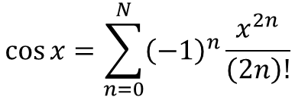
Factorials in a loop: global list is efficient
import time
num_terms=80
x = 0.5
$$\cos{x}=\sum_{n=0}^{N}{{\left(−1\right)}^{n}\frac{x^{2n}}{\left(2n\right)!}}$$
start_time = time.time()
cosine_approx1 = 0
flops1 = 0
for n in range(num_terms):
factv,factf=fact1(2*n)
term = ((-1)**n)*(x**(2*n))/factv
cosine_approx1 += term
flops1 += factf+5
end_time = time.time()
time_taken1 = end_time - start_time
def fact1(n):
if n == 0:
return 1, 0
result = 1; flops = 0
for i in range(1,n+1):
result *= i
flops += 1
return result, flops
start_time = time.time()
flops2=fact2(2*num_terms)
cosine_approx2 = 0
for n in range(num_terms):
term=((-1)**n)*(x**(2*n))/gfact[2*n]
cosine_approx2 += term
flops2 += 6
end_time = time.time()
time_taken2 = end_time - start_time
def fact2(n):
global gfact; gfact=[1]
flops = 0
for i in range(1, n + 1):
gfact.append(gfact[i-1]*i)
flops += 1
return flops
Time, FLOPs & cosine for Approach 1: 0.000998 seconds, 6720, 0.877583
Time, FLOPs & cosine for Approach 2: 0.000000 seconds, 640, 0.877583
http://10.14.0.51/~aru/ph643/fac_cosine.py

Slide 73
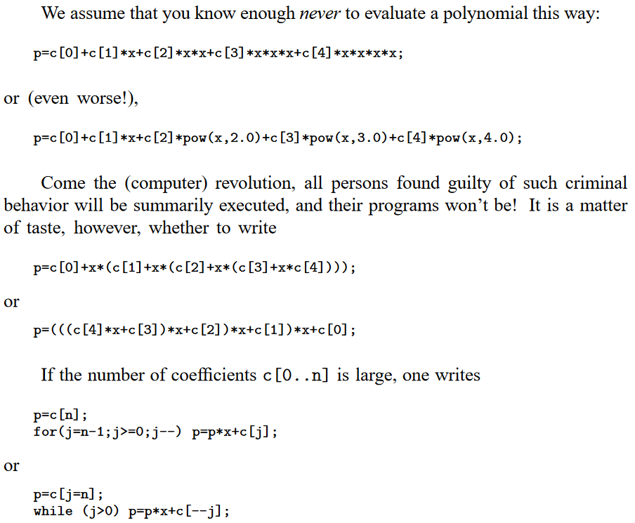
Numerical Recipes in C: The Art of Scientific Computing (1986, Cambridge Univ.)
William T. Vetterling, Brian P. Flannery, William H. Press, Saul Teukolsky

Slide 74
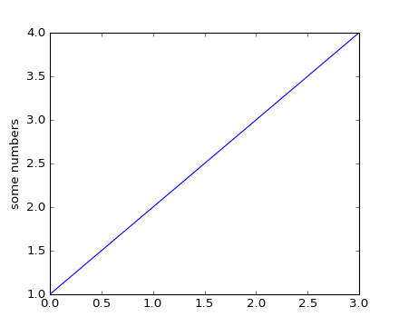
Plots with matplotlib.pyplot
import matplotlib.pyplot as plt
plt.plot([1,2,3,4])
plt.show()
import matplotlib.pyplot as plt
plt.plot([1,2,3,4])
plt.ylabel('some numbers')
plt.show()
To plot x versus y,
plt.plot([1, 2, 3, 4], [1, 4, 9, 16])

Slide 75
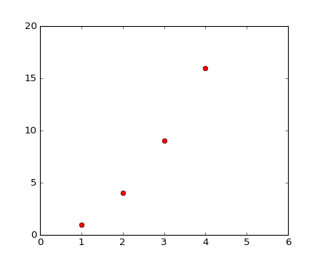
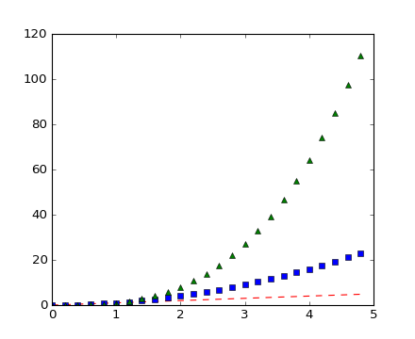
Formatting plots
import matplotlib.pyplot as plt
plt.plot([1,2,3,4], [1,4,9,16], 'ro')
plt.axis([0, 6, 0, 20])
plt.show()
import numpy as np
import matplotlib.pyplot as plt
# evenly sampled time at 200ms intervals
t = np.arange(0., 5., 0.2)
# red dashes, blue squares and green triangles
plt.plot(t,t, 'r--',t, t**2, 'bs',t, t**3,'g^')
plt.show()

Slide 76
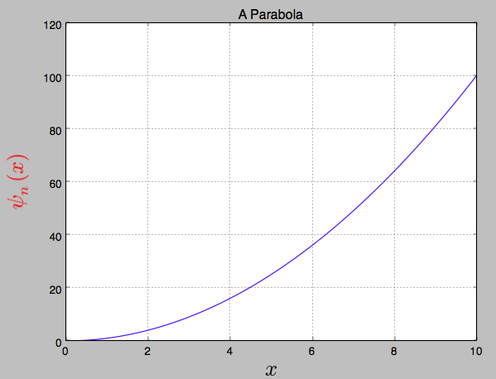
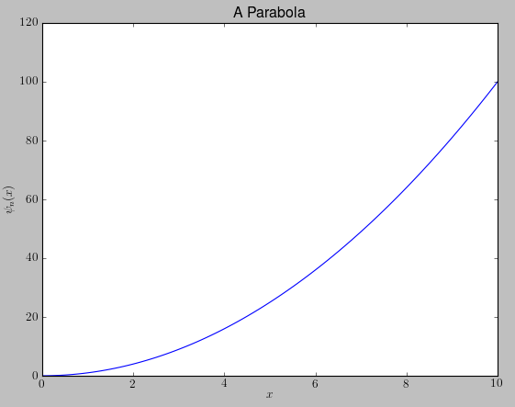
Working with text
import numpy as np
import matplotlib.pyplot as pl
from matplotlib import rc
rc('text',usetex=True)
x=np.arange(0,11,0.1)
y=x**2
pl.plot(x,y)
pl.xlim(0,10)
pl.title('A Parabola')
pl.xlabel(r'$x$')
pl.ylabel(r'$\psi_n(x)$')
pl.show()
pl.grid(True)
pl.ylabel(r'$\psi_n(x)$’,fontsize=24,color=‘red’)

Slide 77
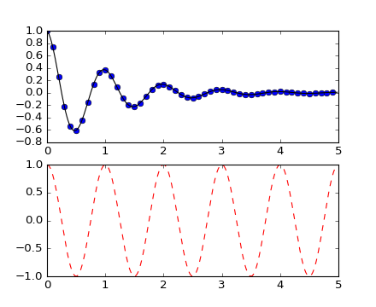
Working with multiple figures and axes
import numpy as np
import matplotlib.pyplot as plt
def f(t):
return np.exp(-t) * np.cos(2*np.pi*t)
t1 = np.arange(0.0, 5.0, 0.1)
t2 = np.arange(0.0, 5.0, 0.02)
plt.figure(1)
plt.subplot(211)
plt.plot(t1, f(t1), 'bo', t2, f(t2), 'k')
plt.subplot(212)
plt.plot(t2, np.cos(2*np.pi*t2), 'r--')
plt.show()
The subplot call specifies
numrows, numcols, plot_number where plot_number ranges from
1 to numrows*numcols.
The commas in the subplot call are optional if numrows*numcols<10.
subplot(211) is identical to subplot(2, 1, 1)

Slide 78
Other options in a plot
plt.text(60, .025, r'$\mu=100,\ \sigma=15$')
plt.yscale('linear')
plt.yscale('log')
https://matplotlib.org/stable/tutorials/index.html

